Slide 1

Group 1
What factors contribute to a patient's time between visits during their patient journey?
Jessica Xie, Emme Heimlich, Ava Corwin, Louisa Lehmann
Notes:
We are Group 1, I am Louisa, this is Jessica, Emma, and Ava.
Our research question for this analysis was “What factors contribute to a patient’s time between visits during their patient journey?”
Our goal was that in finding significant factors, SVH could learn how or in what areas to support their patients.

Slide 2
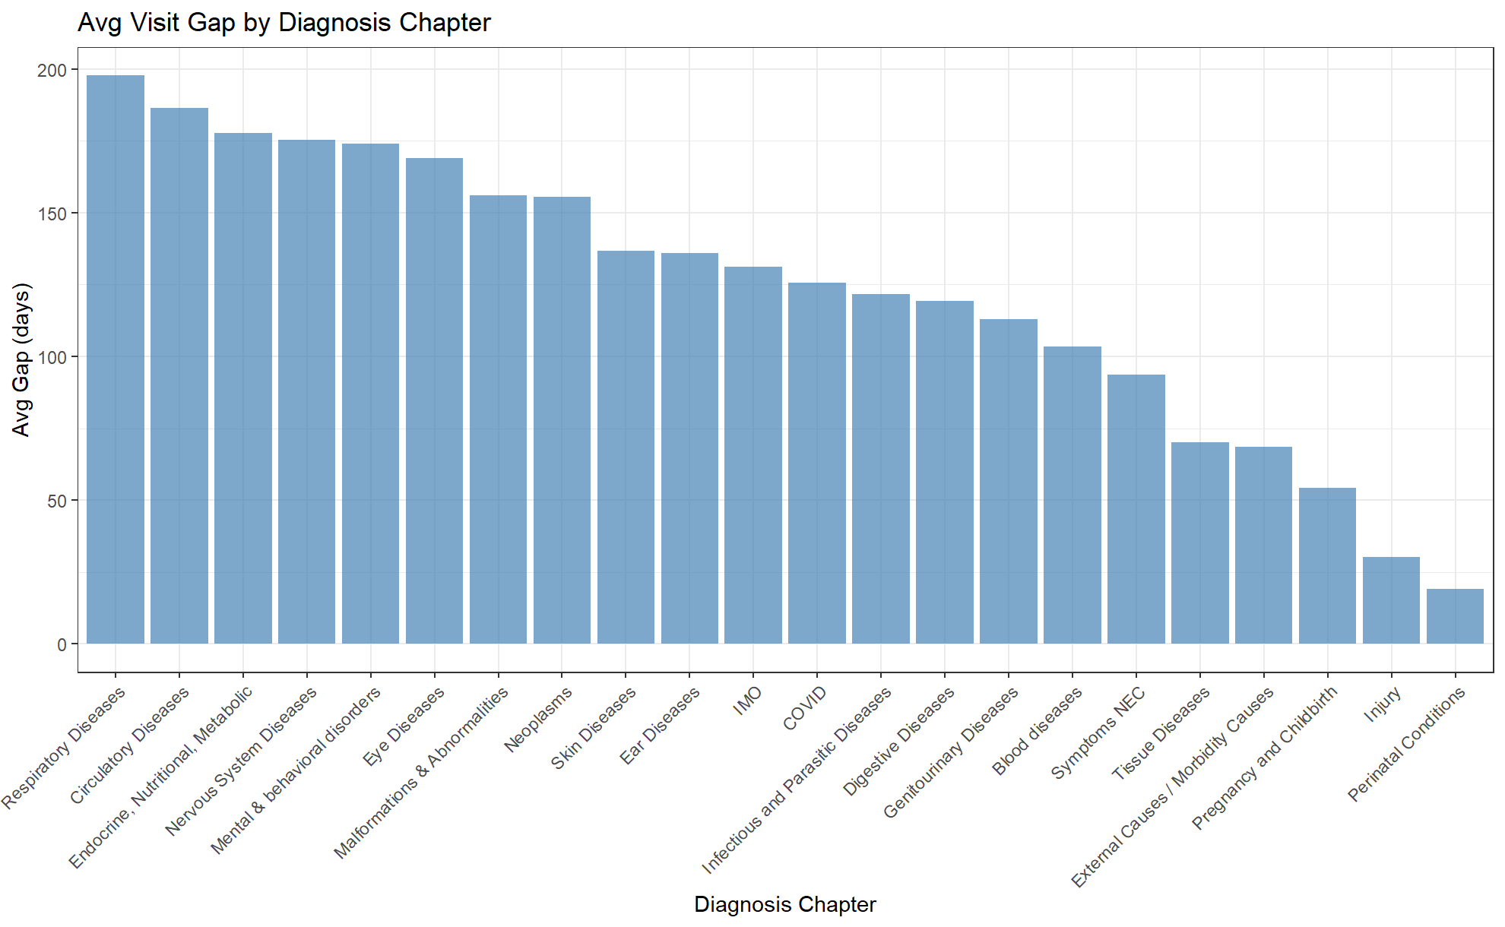
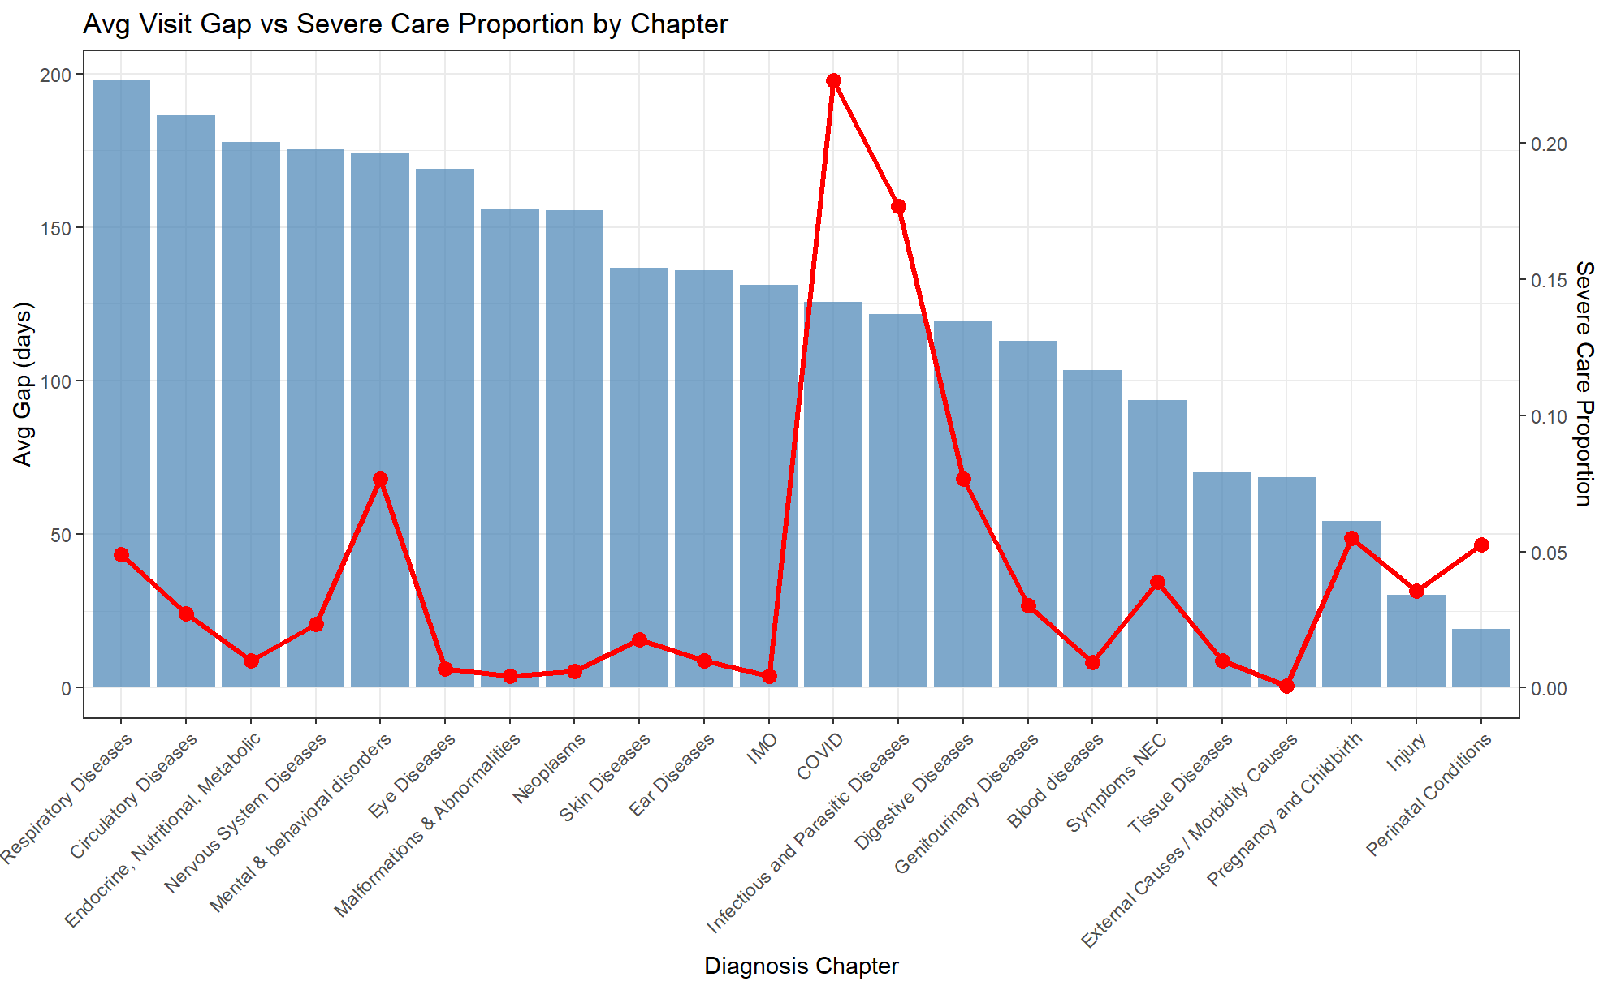
Mixed effects model and ANOVA with null model
Model: avg_gap ~ Chapter + (1|PatientDurableKey)
P-value: 2.2e^-16
Significant difference in wait times between diagnoses

Slide 3
Patient Journey
Average Wait Time
Avg Diagnosis Wait Time
Difference
The Format of Our Analysis: Controlling for Diagnoses
Diagnosis Group A
Diagnosis Group B
Diagnosis Group C
Diagnosis Group D
Average Diagnosis A Wait Time
Average Diagnosis B Wait Time
Average Diagnosis C Wait Time
Average Diagnosis D Wait Time
Notes:
After concluding that the diagnosis group was significant, we wanted to control for those different wait time in the rest of our analysis.
So this slide is just telling the story of how we formatted our analysis.
Each patient journey, of which there are hundred of thousands, has an average wait time between visits. To note, we only looked at journeys with at least 2 visits.
Each diagnosis is part of a broader diagnosis group—for example, left ankle fracture and right ankle fracture are different journeys for a patient, but the same diagnosis group.
Specific diagnosis groups will require different tests or different specialists, so wait time within a group is significant.
The weighted average time between visits for each diagnosis group is calculated, and brought back up and attached to the patient journey data.
From there, we can calculate the difference between this patient’s wait time and the typical wait time for a similar diagnosis.

Slide 4
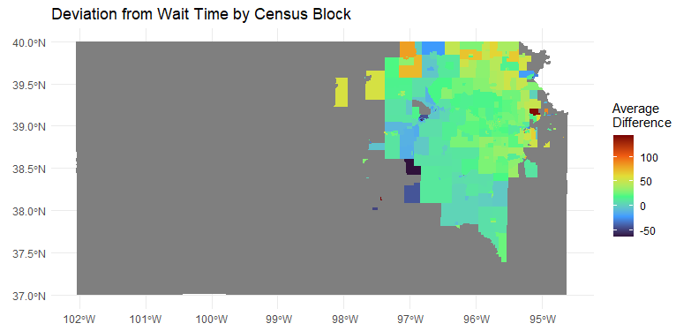
Deviation from Wait Time by Census Block
Rural counties with < 20 patient journeys are excluded.
No indication that distance from centers in Topeka, Kansas or rurality affects wait times.

Slide 5
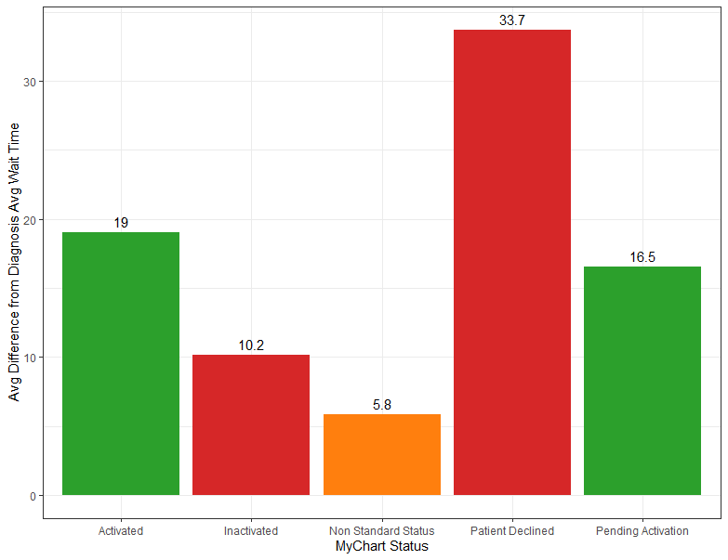

Deviation from Wait Time by MyChart Status
1 tailed t-test:
H₀: $μ$_{active} $≥$ $μ$_{inactive}
H₀: $μ$_{active} $<$ $μ$_{inactive}
P-value = .99
Conclusion: There is no evidence that active patients in MyChart have shorter wait times than inactive patients.

Slide 6
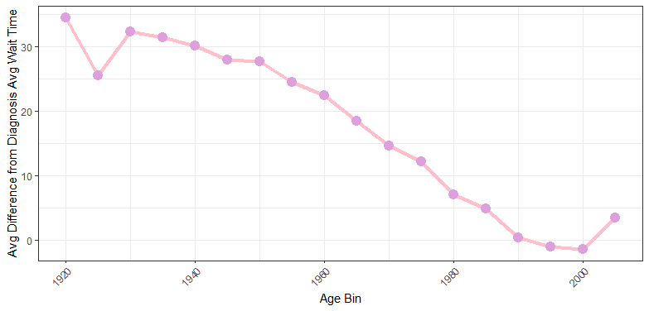

Deviation from Wait Time by Birth Year, Ages 18+
Possible Factors:
Severity of condition/ medical complexity
Technological literacy
Transportation barriers
Developmental milestones
*Does not include children
$$\hat{diff}=783 − .389∗BirthYear$$
95% Confidence Interval for birth year: (-.41, -.37)
There is evidence of a significant relationship between age and wait time.

