Slide 1

MyChart
Analysis
Mamie Magdalene, Liangjun He, Ryan Wahle, Spencer Steinmeyer

Slide 2
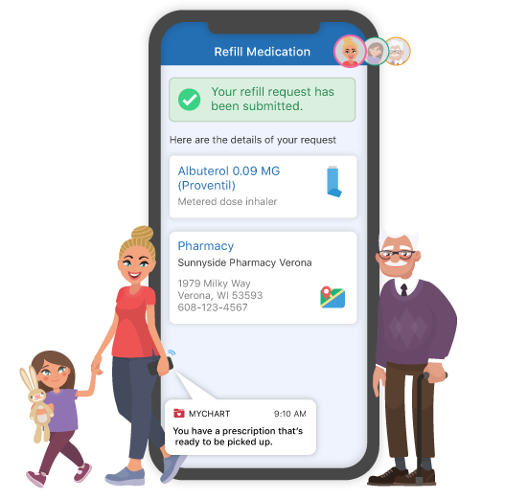
Through MyChart patients can
Contact their provider
View their medical records
Obtain prescription refills
More
Use of a healthcare portal is associated with preventative health behaviors and in some cases better health outcomes
However, only 29% of patients are Active in MyChart.
Why? And how can we address this?
?
!

Slide 3
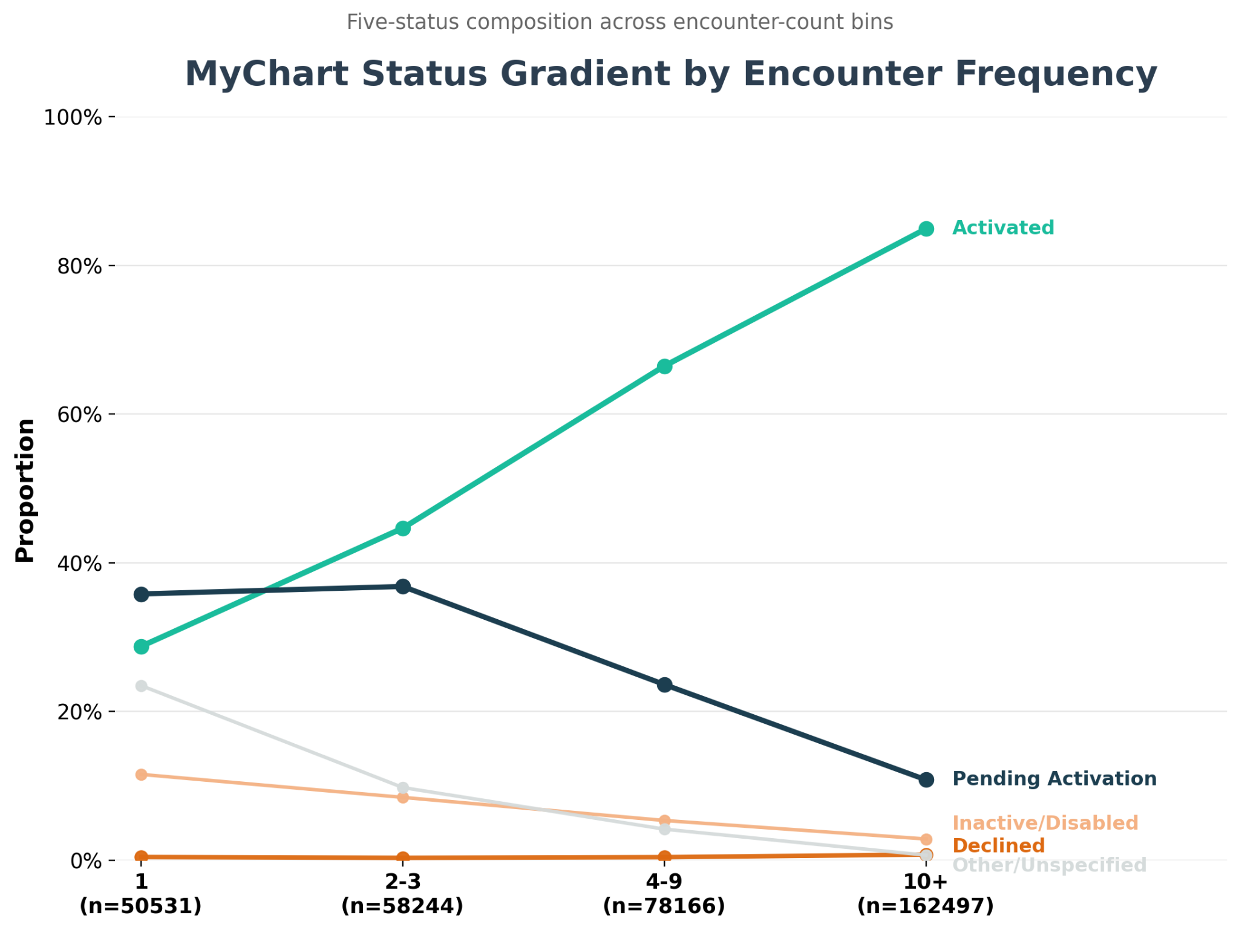

Slide 4
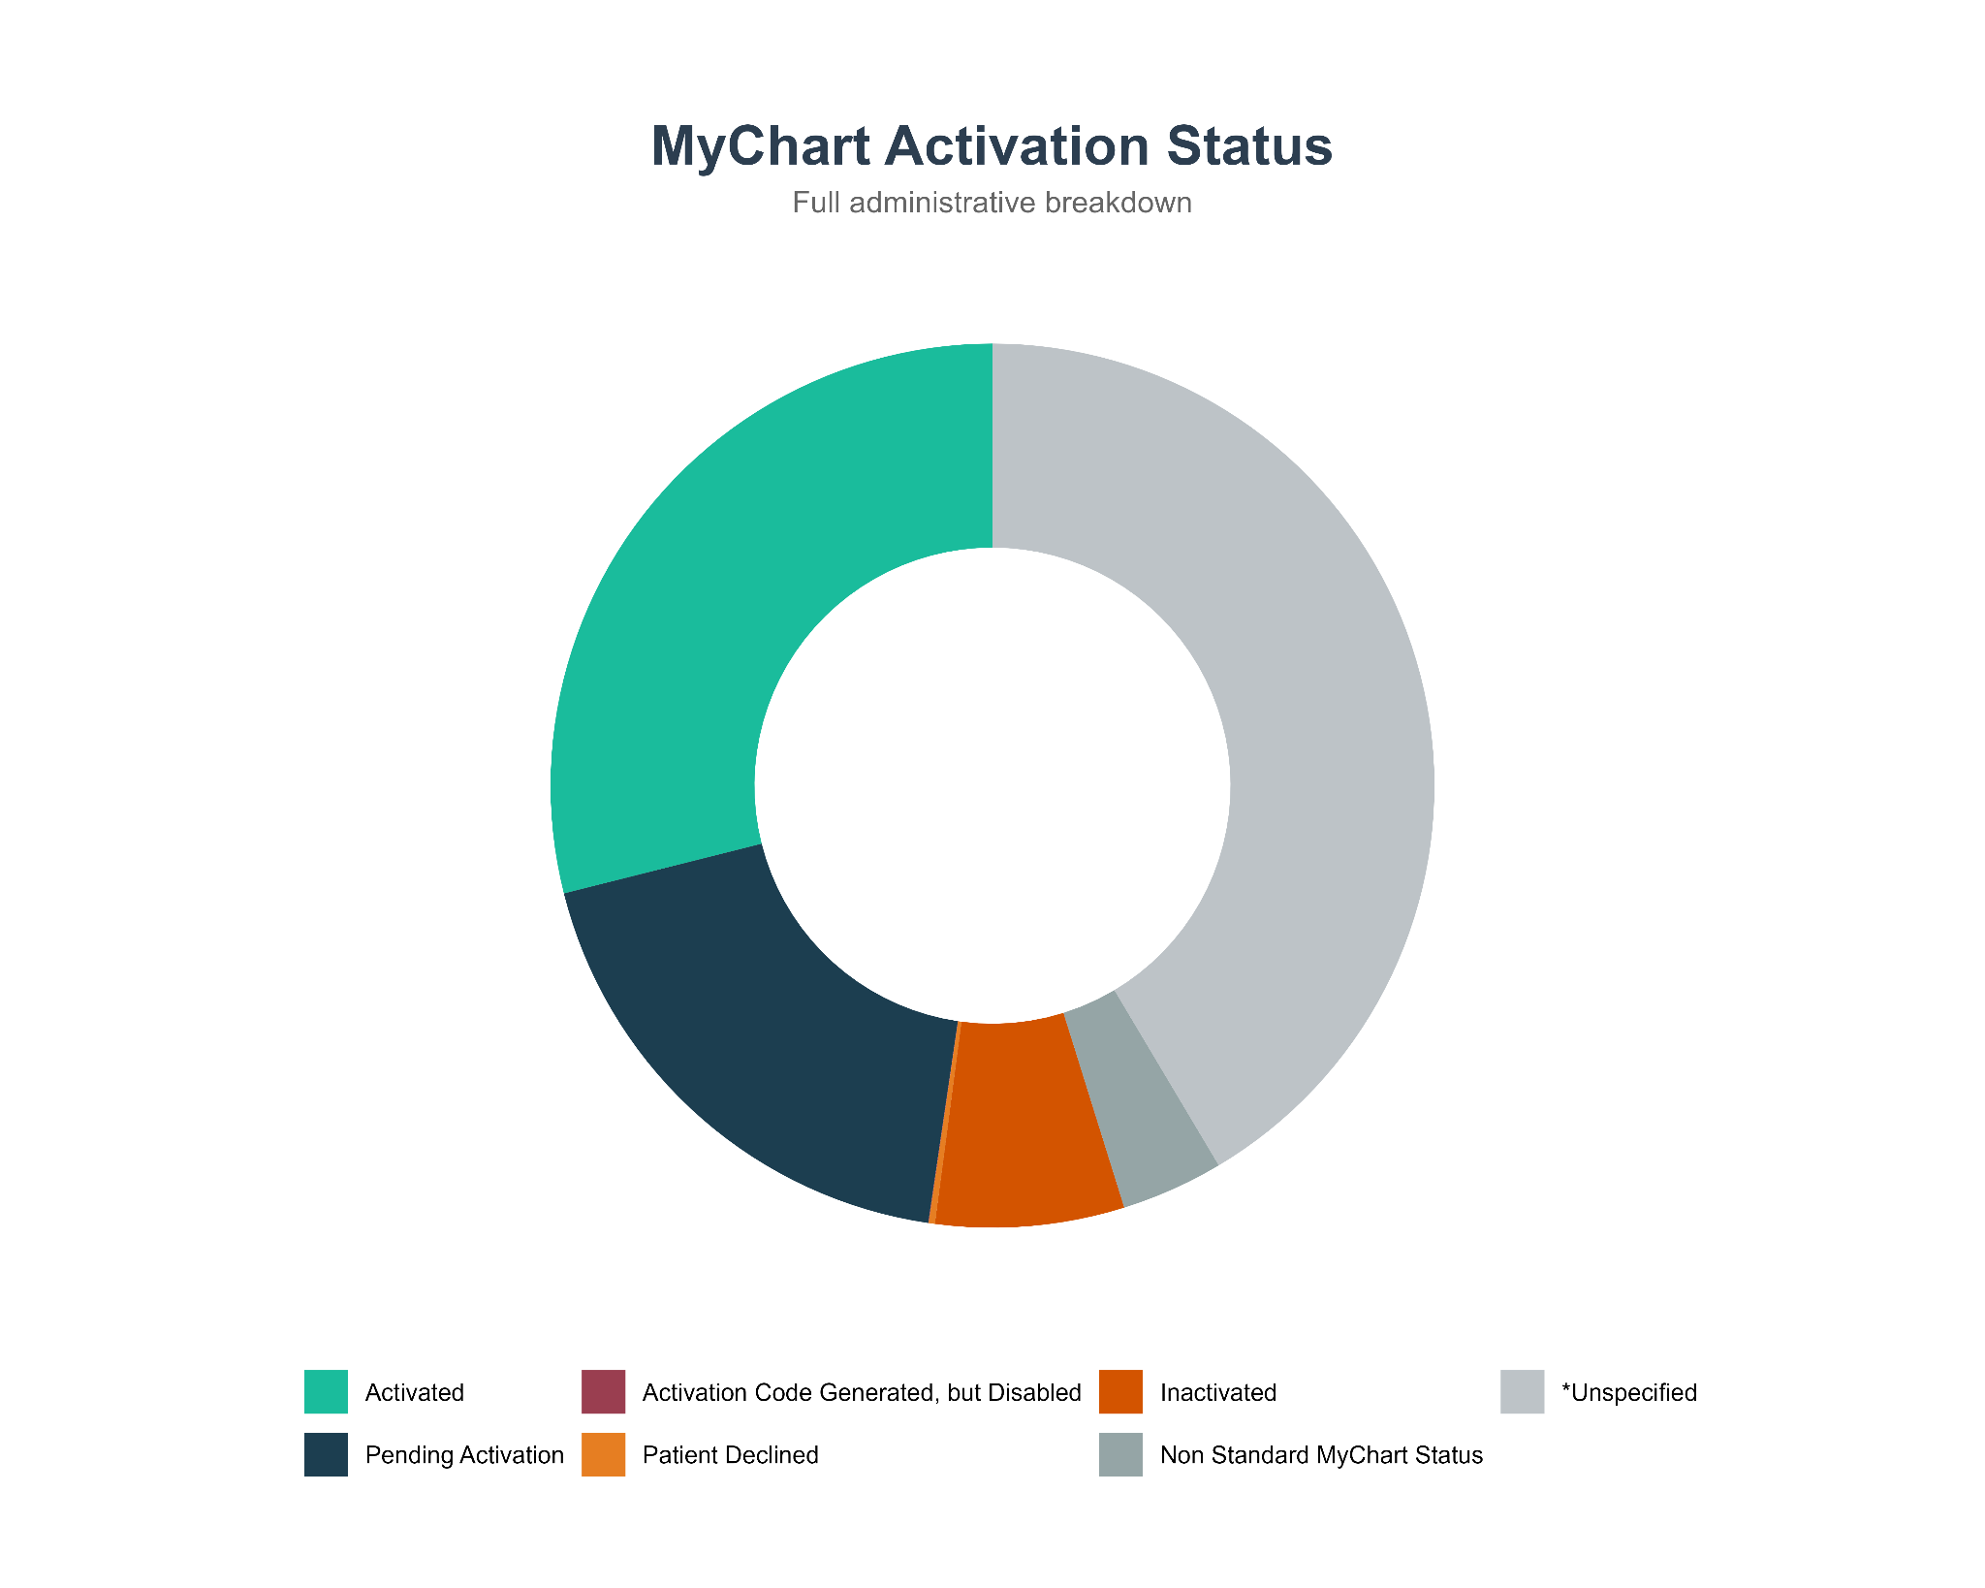


41% of patient’s accounts are “*Unspecified”

Slide 5
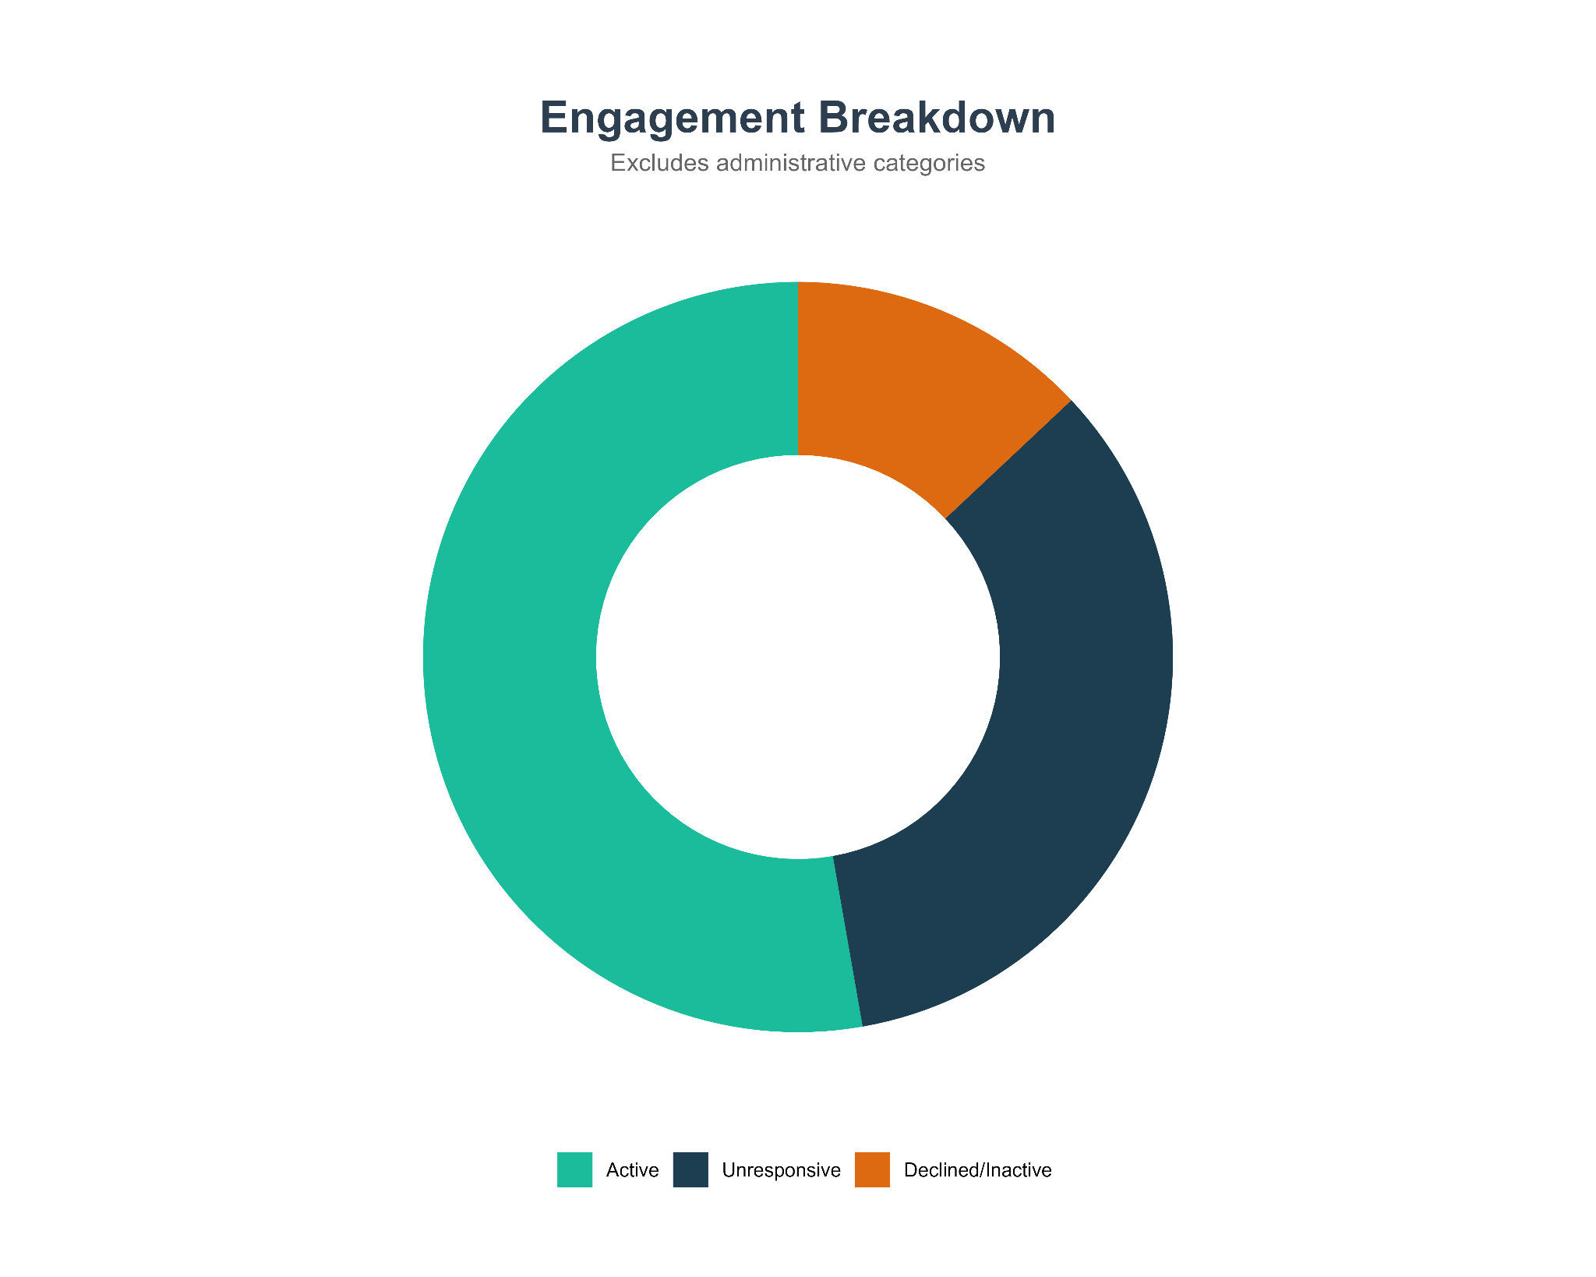


MyChart status put into three groups

Slide 6
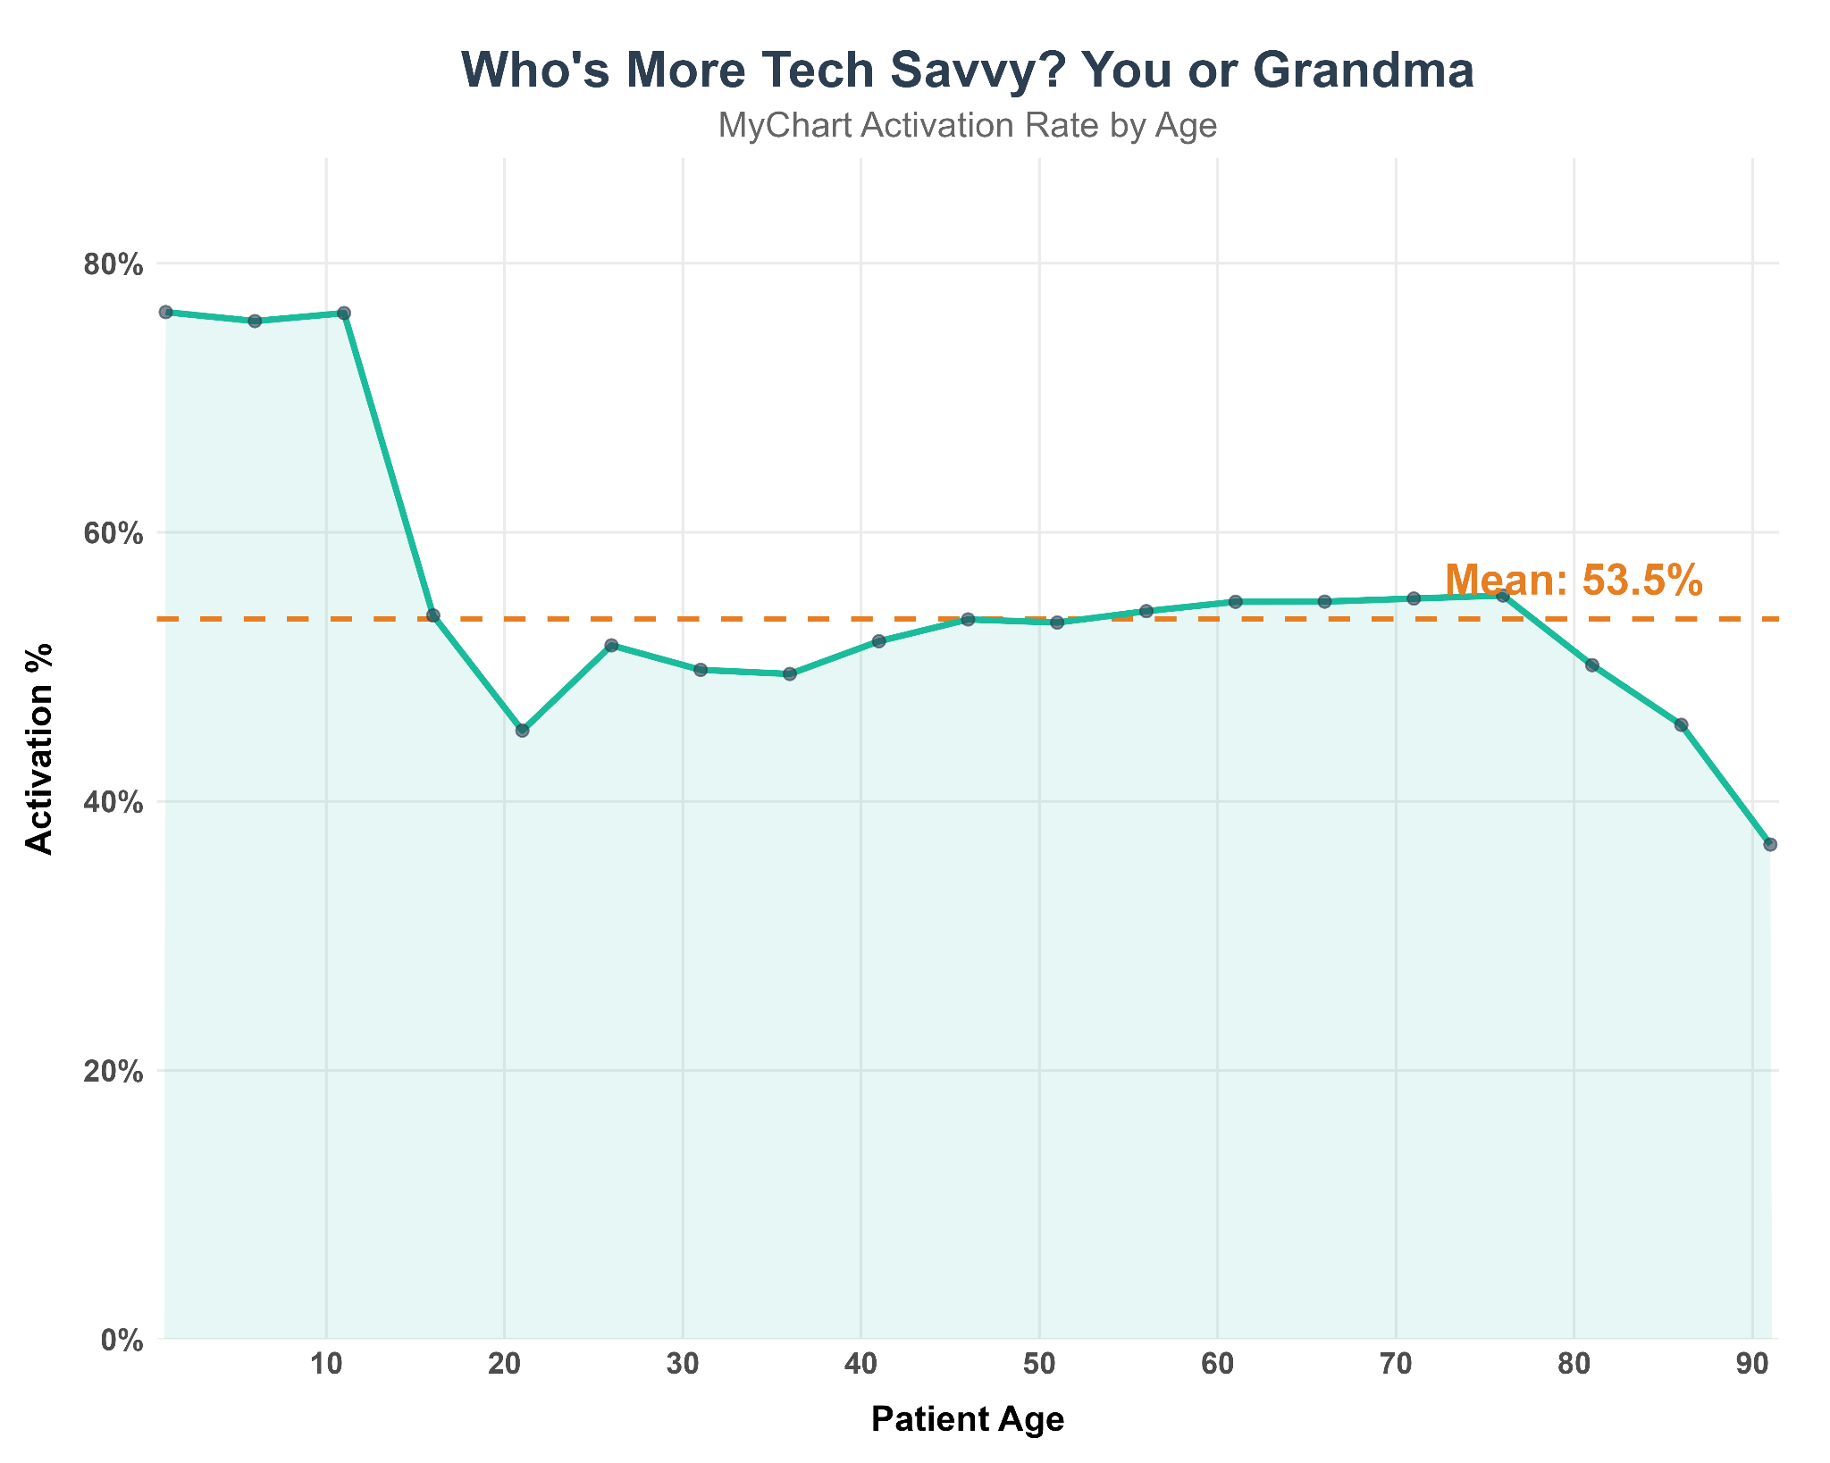
Proxy Feature for Retirees
  Allows for patients to have their caretaker to manage their account
Young adults lack engagement
Notes:
According to Vanderhout et al. (2025) who also conducted an analysis on

Slide 7
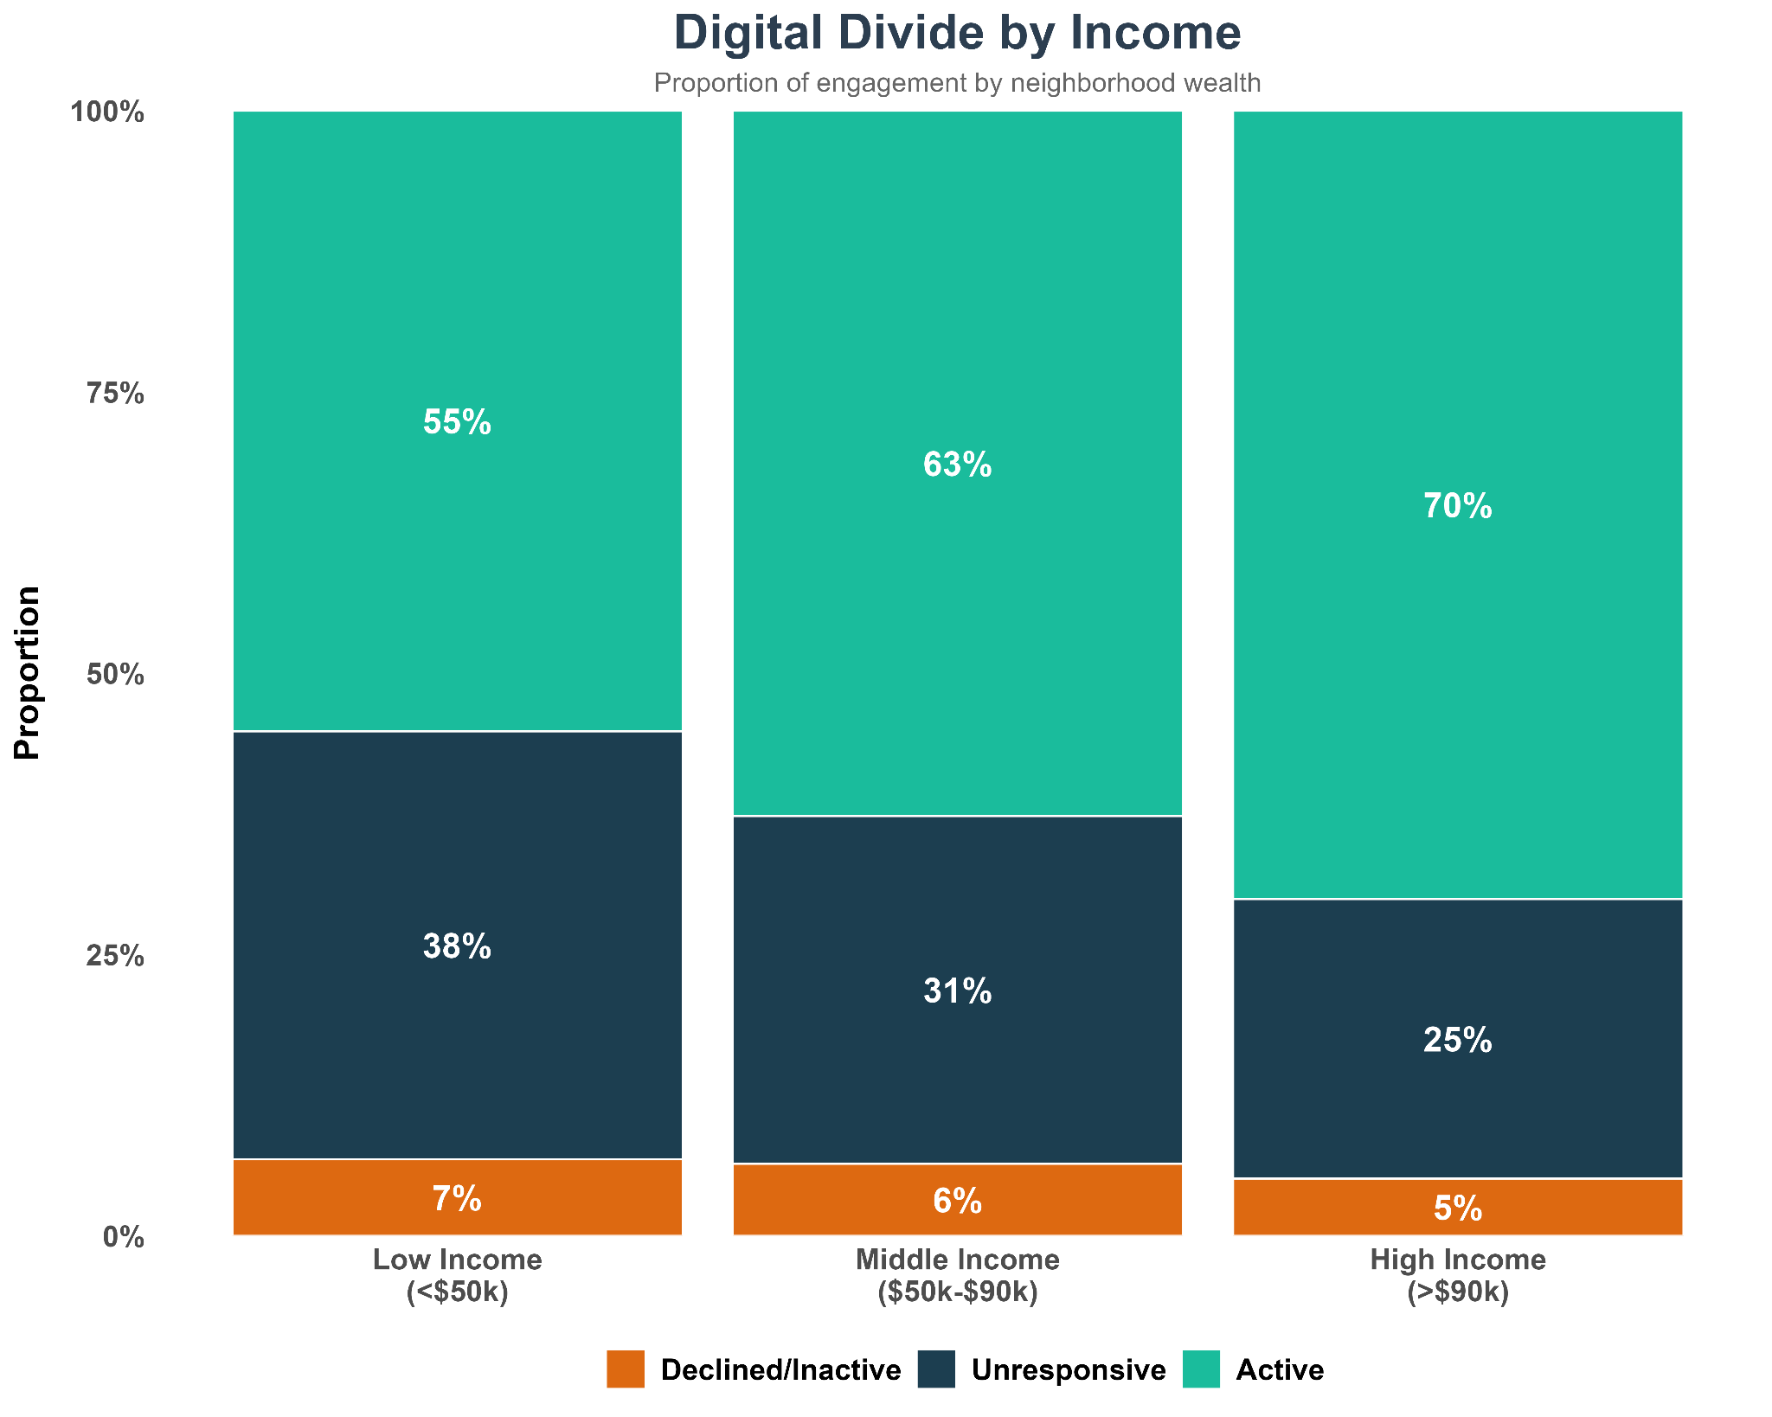
Income - Key Driver
High income population:
More likely to use MyChart
  Contributing factors (Higher tech literacy among caregivers)
More engaged in healthcare process

Slide 8
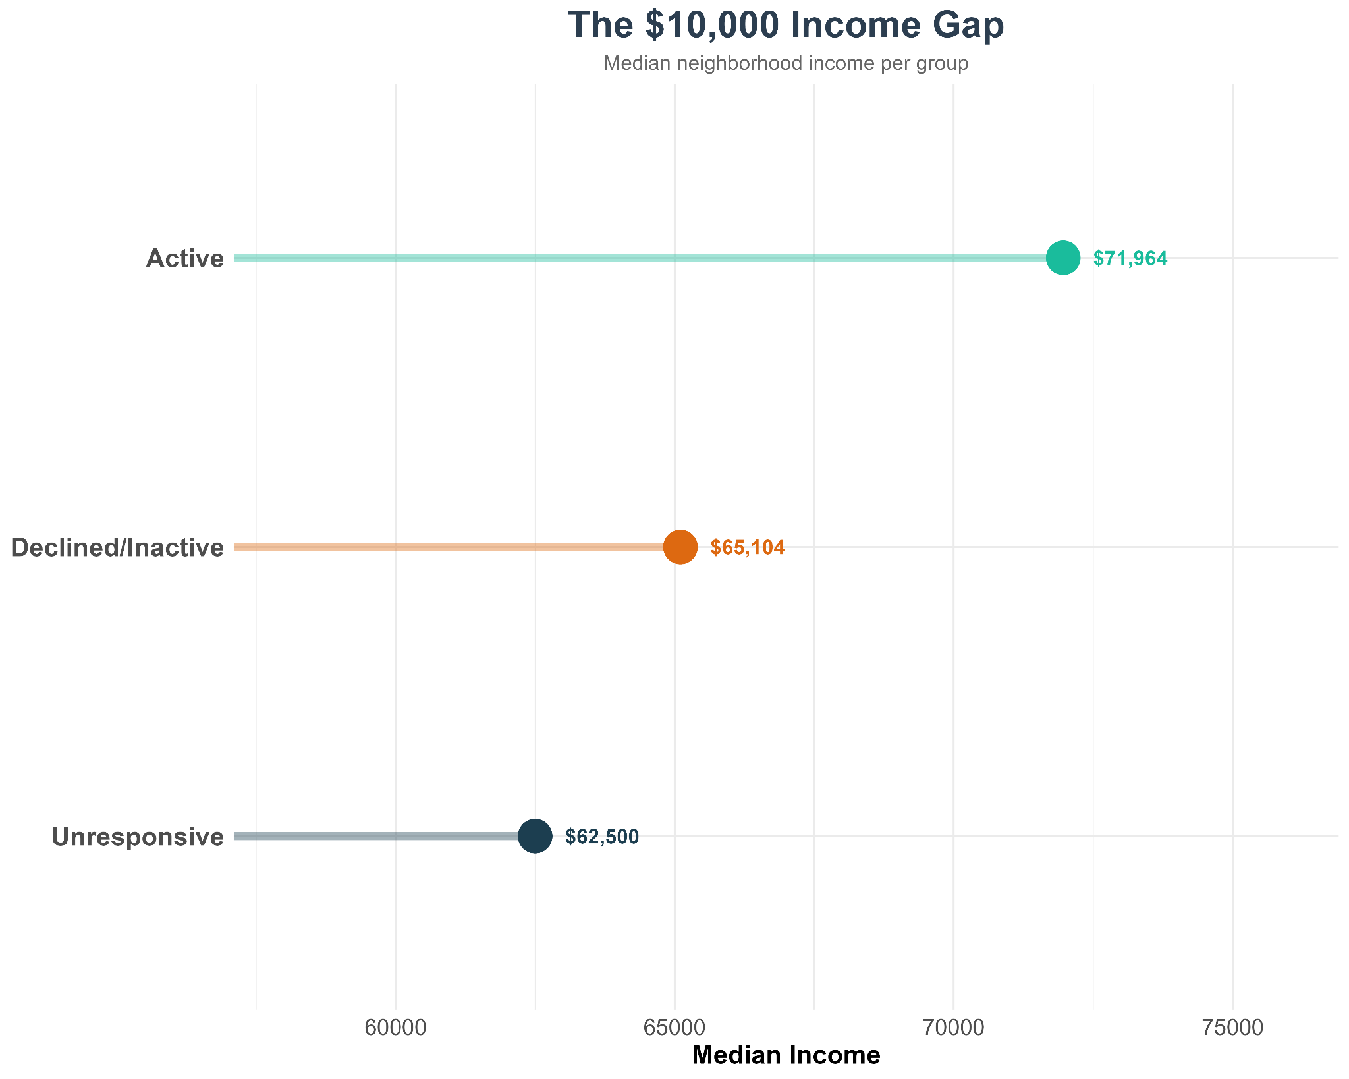
The following differences in income between different MyChart statuses are statistically significant, showcasing how socioeconomic situations factor into healthcare disparity

Slide 9
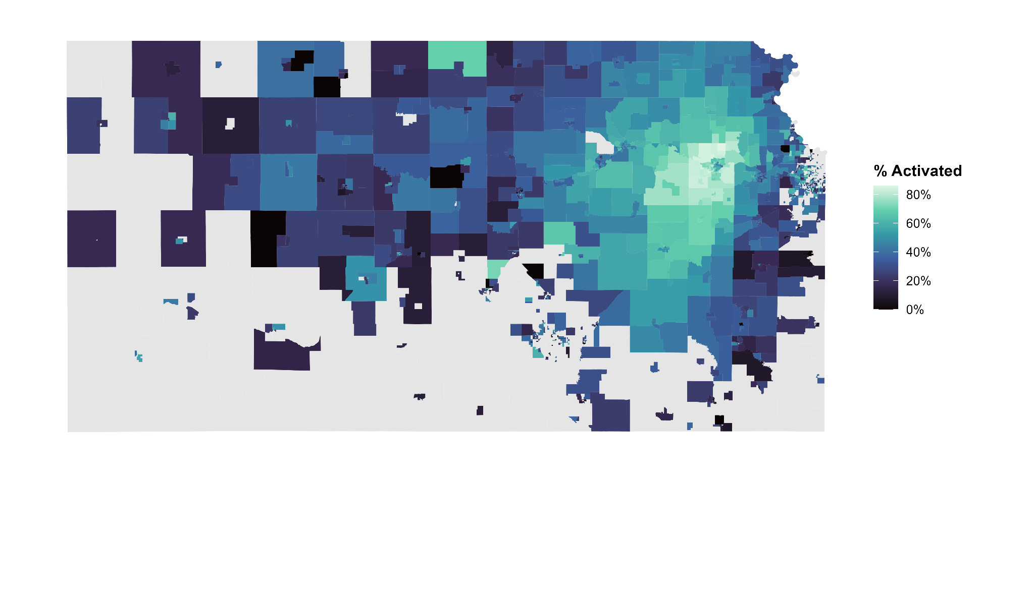

What trends do we see?
Concentration around Topeka, KS
Distance from care

Slide 10
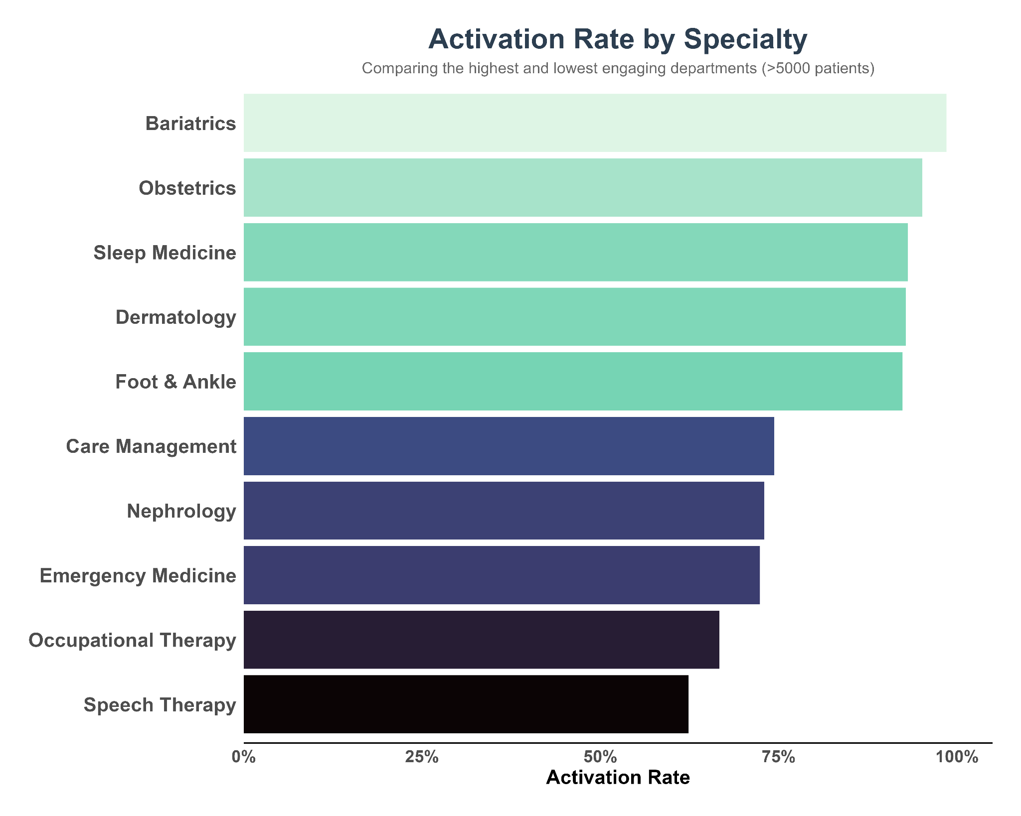
What can the bottom 5 specialties learn from the top 5?

Slide 11
How to Reach the Non-Users
Non-users cite two main barriers to using MyChart
  Lack of awareness (59%)
  Registration Difficulties(32%)
How to address this
  Have patient-facing healthcare workers educate patients on the benefits of MyChart and other healthcare portals
  Create pamphlets outlining benefits, sign-up process, and support contacts

Slide 12
References
About MyChart | MyChart. (n.d.). www.mychart.org. https://www.mychart.org/About
Carini, E., Villani, L., Pezzullo, A. M., Gentili, A., Barbara, A., Ricciardi, W., & Boccia, S. (2021). The Impact of Digital Patient Portals on Health Outcomes, System Efficiency, and Patient Attitudes: Updated Systematic Literature Review. Journal of medical Internet research, 23(9), e26189. https://doi.org/10.2196/26189
Vanderhout, S., Taneja, S., Kalia, K., Wodchis, W. P., & Tang, T. (2025). Patient Experiences and Perspectives When MyChart is Introduced in a Large Community Hospital: Mixed Methods Study. Journal of medical Internet research, 27, e66353. https://doi.org/10.2196/66353

