Slide 1


Animal Scientists
DataFest 2026
Statistical Analysis
Presented By:
Gwendolyn Overholt, Khadicha Nurakhmedova, Rachel Hanenkratt, Anthony Gandolfo

Slide 2


Animal Scientists - Datafest 2026
Intro
duction
This statistical analysis looks at patient encounter data gathered over four years to gain information about healthcare utilization trends and the evolution of patient experiences over time.
This project looks at how people move through the healthcare system to find trends, gaps, and possible inefficiencies in care delivery.

Slide 3
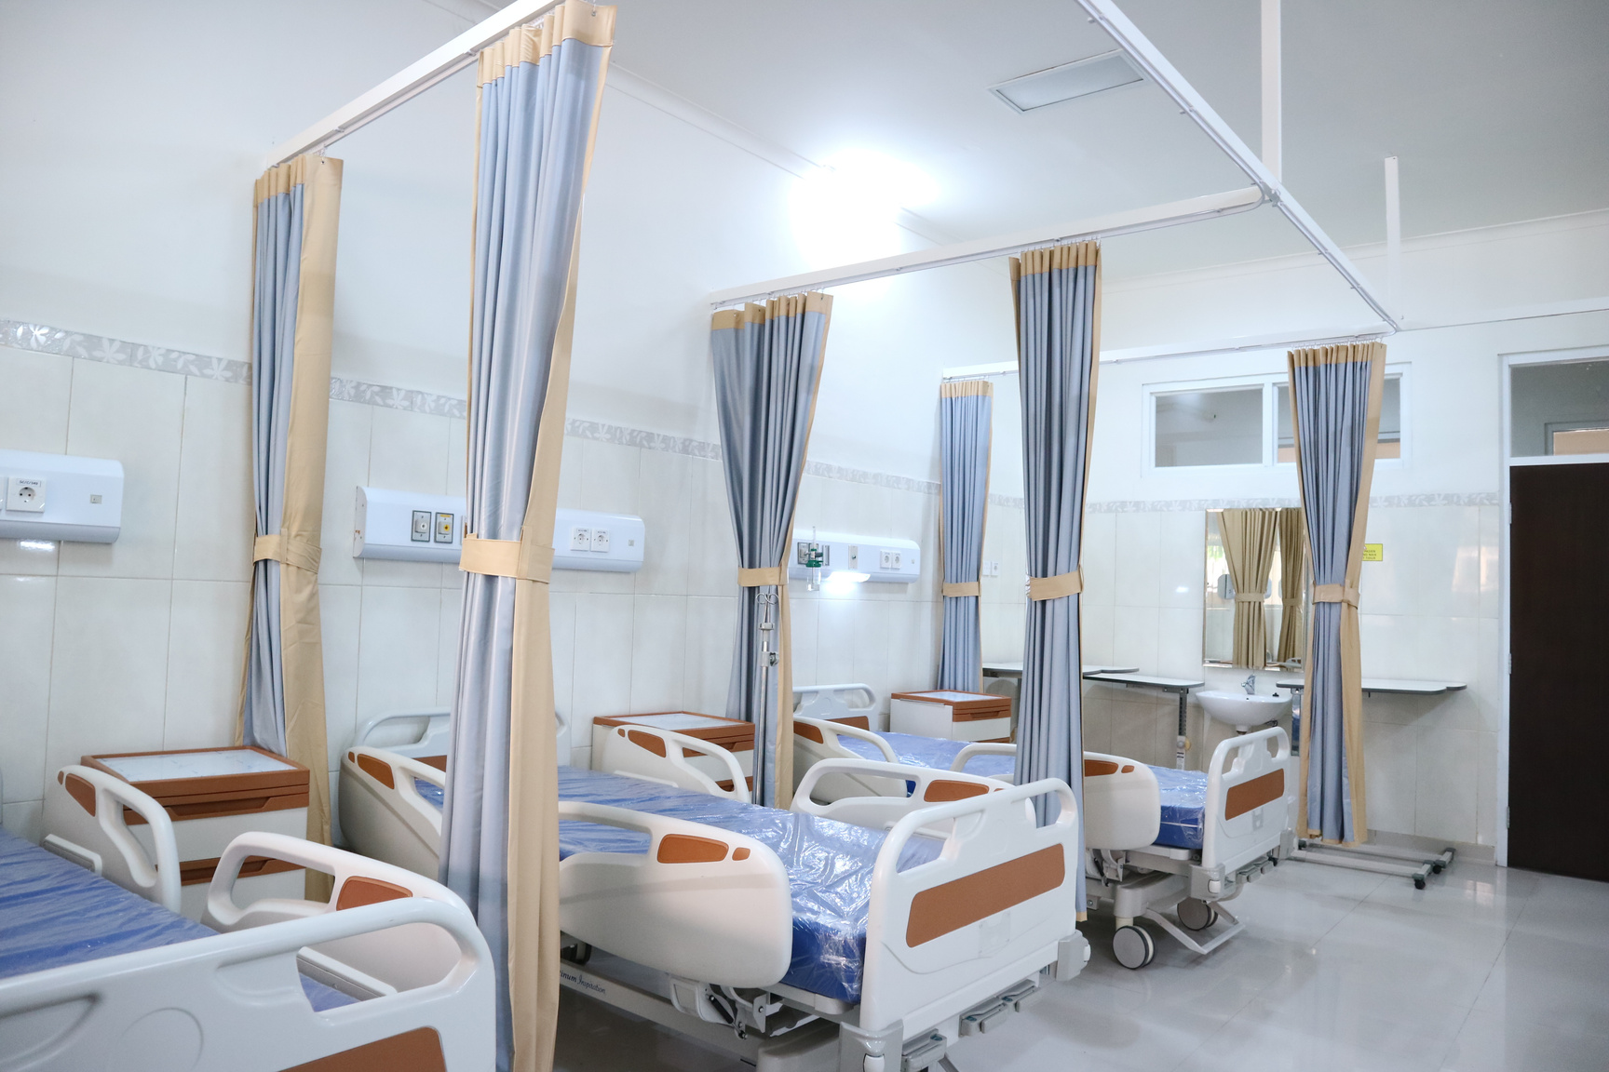
Animal Scientists - Datafest 2026
Problem
Distance and Accessibility Issues
  Are patients that reside farther away from the hospital less likely to return?
  Is MyChart activation associated with stronger 30-day follow-up?
  Do transportation and financial barriers add significant risk?

Slide 4
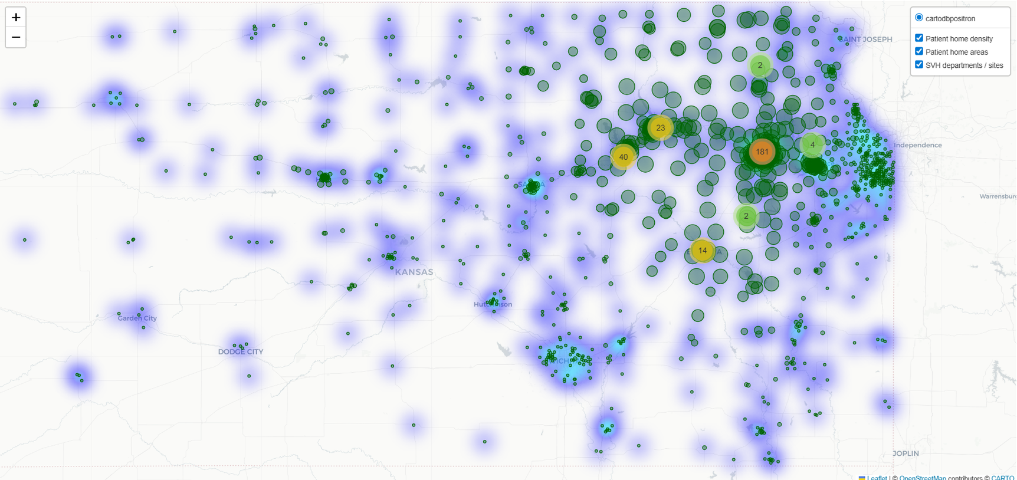
Outcome
  30-day follow-up
  Returned within 30 days = 1
  No return = 0
Key predictors
  Distance bucket: <5, 5–15, 15–30, 30+
  MyChart status
  Transportation hardship
  Financial hardship
  Age group
  Year
Model
  Logistic regression
  Odds of 30-day follow-up
  Adjusted pairwise contrasts
  Social Determinants of Health
Animal Scientists - Datafest 2026
Methods

Slide 5
Animal Scientists - Datafest 2026
  Patients 30+ miles away had the lowest adjusted follow-up
  Significantly worse than every closer group
  Pairwise contrasts confirmed a true threshold effect
Main Finding
Distance (mi) | Follow up %
<5 | 20.2%
5-15 | 20.6%
15-30 | 19.7%
30+ | 18.2%
30+ miles = significantly lower continuity (p < 0.001)

Slide 6
Other Determinants
Transportation
MyChart Pending Activation
Financial Hardship
11% lower odds
OR = 0.89
p < 0.001
15% lower odds
OR ≈ 0.85
p < 0.001
9% higher odds
OR = 1.09
p < 0.001

Slide 7
Animal Scientists - Datafest 2026
Conclusions
Interpretations
Recomendations
  The greatest barriers to patient’s returning to the hospital for follow-up care are distance, lack of transportation, and disengagement with Mychart
  Pre-scheduling next appointments before discharging patient
  Digital engagement with patients after discharge to encourage activating Mychart
    especially patients 15+ miles away

Slide 8
Thank you

